Slide 1

OCTOBER 2025
LAS TRADERS
Testing Asset Pricing Models
AILEEN LI, LUKE HARTFIELD, SAMAY MOHAPATRA
The University of Texas at Austin

Slide 2
INTRODUCTION
Build a reproducible Python framework that:
Retrieves and cleans data from Ken French library.
Runs time-series regressions for CAPM and FF3.
Executes joint (alpha = 0) GRS-F tests and Fama-MacBeth cross-sectional tests.
Outputs Excel summaries and diagnostics.
Key Goal: Assess whether the additional SMB (size) and HML (value) factors improve model fit and reduce pricing errors vs. CAPM.

Slide 3
DATA PREPROCESSING
Automated download and parsing from Ken French website
Extracted:
25 portfolio return series (monthly)
Factor data: MKT - RF, SMB, HML, and RF
Converted returns to decimal format
Standardized and validated date inputs for flexible analysis windows
Aligned portfolio and factor data via monthly PeriodIndex
User Input Feature for Date Range and choice of CAPM, FF3F, or Both

Slide 4
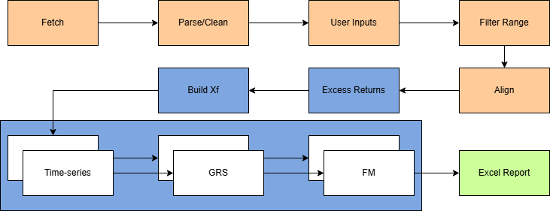

Slide 5
SUMMARY STATISTICS
Computed for each portfolio:
  Mean, Std. Dev., Sharpe Ratio, T
  Provided an overview of portfolio-level risk and performance
  Context for future model evaluations

Slide 6
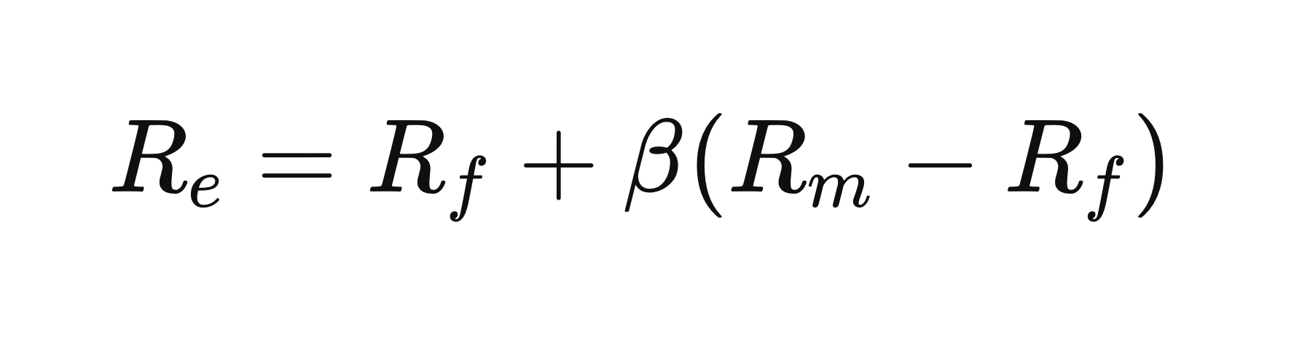
MODEL ESTIMATION
CAPM
FAMA FRENCH
Notes:
Rm - nyse and smth else

Slide 7
REGRESSION RESULTS
GRS - F Test
Alphas, Betas, R², t-stats, standard errors
Predicted returns & residuals
Covariance matrices (residuals & factors)
Tests joint significance of portfolio alphas
Null hypothesis: alphas are 0
Accounts for residual and factor covariance structure
Reports F-statistic and p-value
Rejection → model fails to fully explain returns

Slide 8
CAPM Results
GRS F = 2.84, p = 1.2×10⁻⁵ → Reject H₀.
Significant alphas → CAPM fails to fully price portfolios.
Market beta explains direction, not magnitude of returns.
Notes:
Rejection means that, even after accounting for the model’s factors, there remain systematic abnormal returns across the 25 portfolios that the model cannot explain. In other words, the benchmark is not mean–variance efficient for this test set

Slide 9
FF3F Results
R² improves (0.59 → 0.93)
SMB and HML both significant → capture size and value effects
GRS F = 1.99, p = 0.0036 → still reject H₀, but weaker
Residual alphas smaller → FF3F dominates CAPM
Observation: Value and small-cap portfolios deliver higher average returns → evidence of value and size premia.

Slide 10
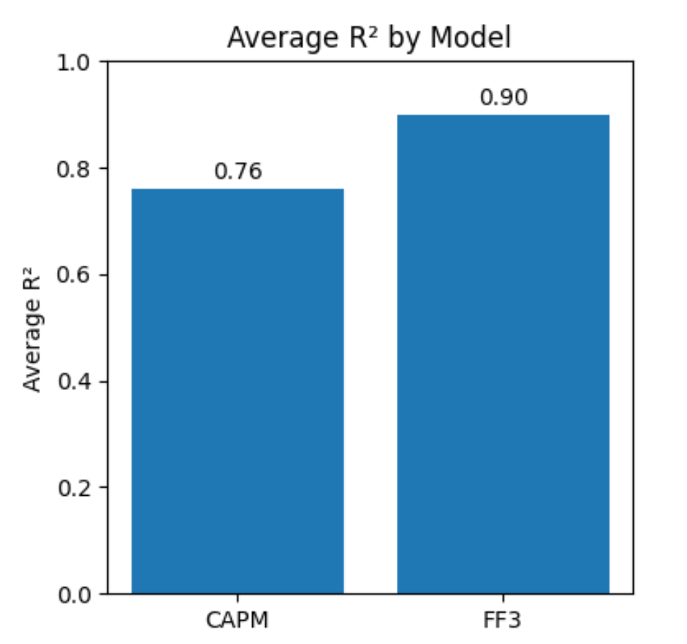
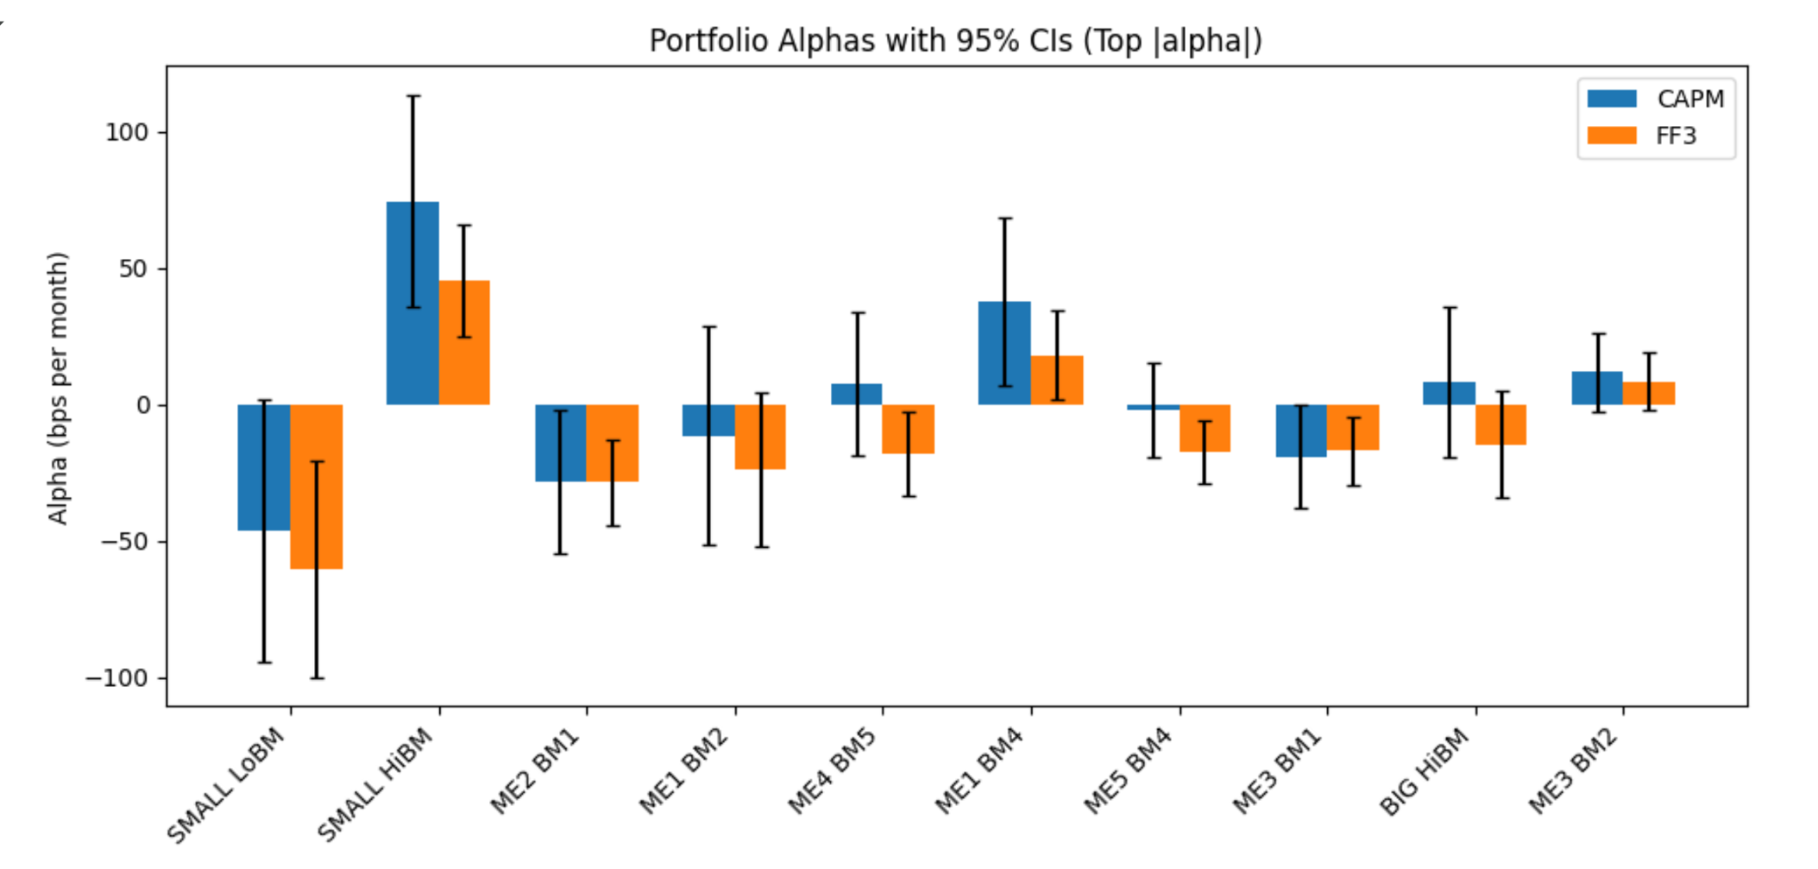
Jul-1926 to Aug-2025
Notes:
Add a quick visual of alphas or R²
Consider a bar chart of alphas for CAPM vs FF3 (first 10 portfolios is fine), or a side-by-side table of average R² and mean |alpha|.
This gives a quick visual sense of how FF3 “shrinks” alphas and improves fit, instead of just stating it.
Here we’re looking at the time-series regression results from CAPM and Fama–French 3-factor.
On the chart you see the estimated alphas and the R² values across the 25 size–book-to-market portfolios.
The takeaway is that CAPM leaves larger and more significant alphas, especially in the small-cap and value portfolios. The R² values are also generally lower.
When we move to Fama–French, the alphas shrink and the R² improves across most portfolios, which tells us the extra SMB and HML factors explain more of the variation in returns.
But since the alphas are not all zero, it suggests even FF3 doesn’t perfectly price these portfolios.”
—-----------------
“Over the full sample, CAPM leaves sizable positive and negative alphas across many portfolios, especially on the value side; R² is moderate.”
“Adding SMB and HML (FF3) shrinks alphas and raises R² a lot (roughly from around 0.6 to around 0.9 on average).”
“This means the extra factors capture more of the month-to-month variation in returns, but not necessarily every average pricing error.”

Slide 11
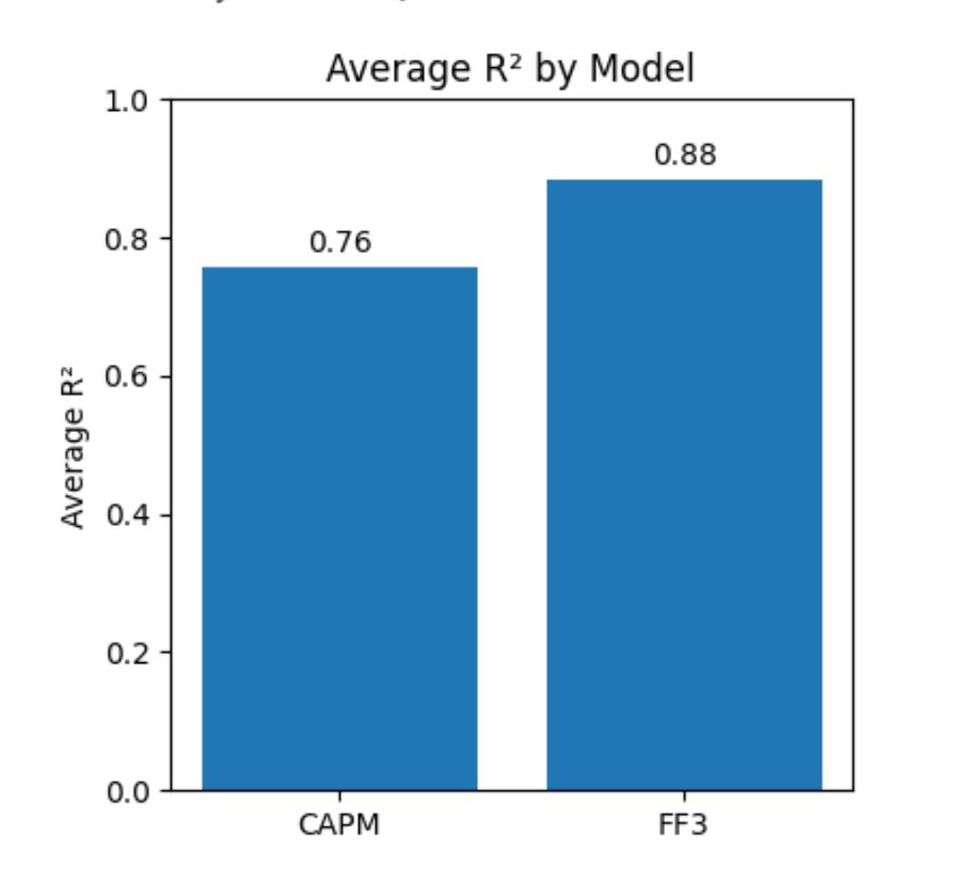
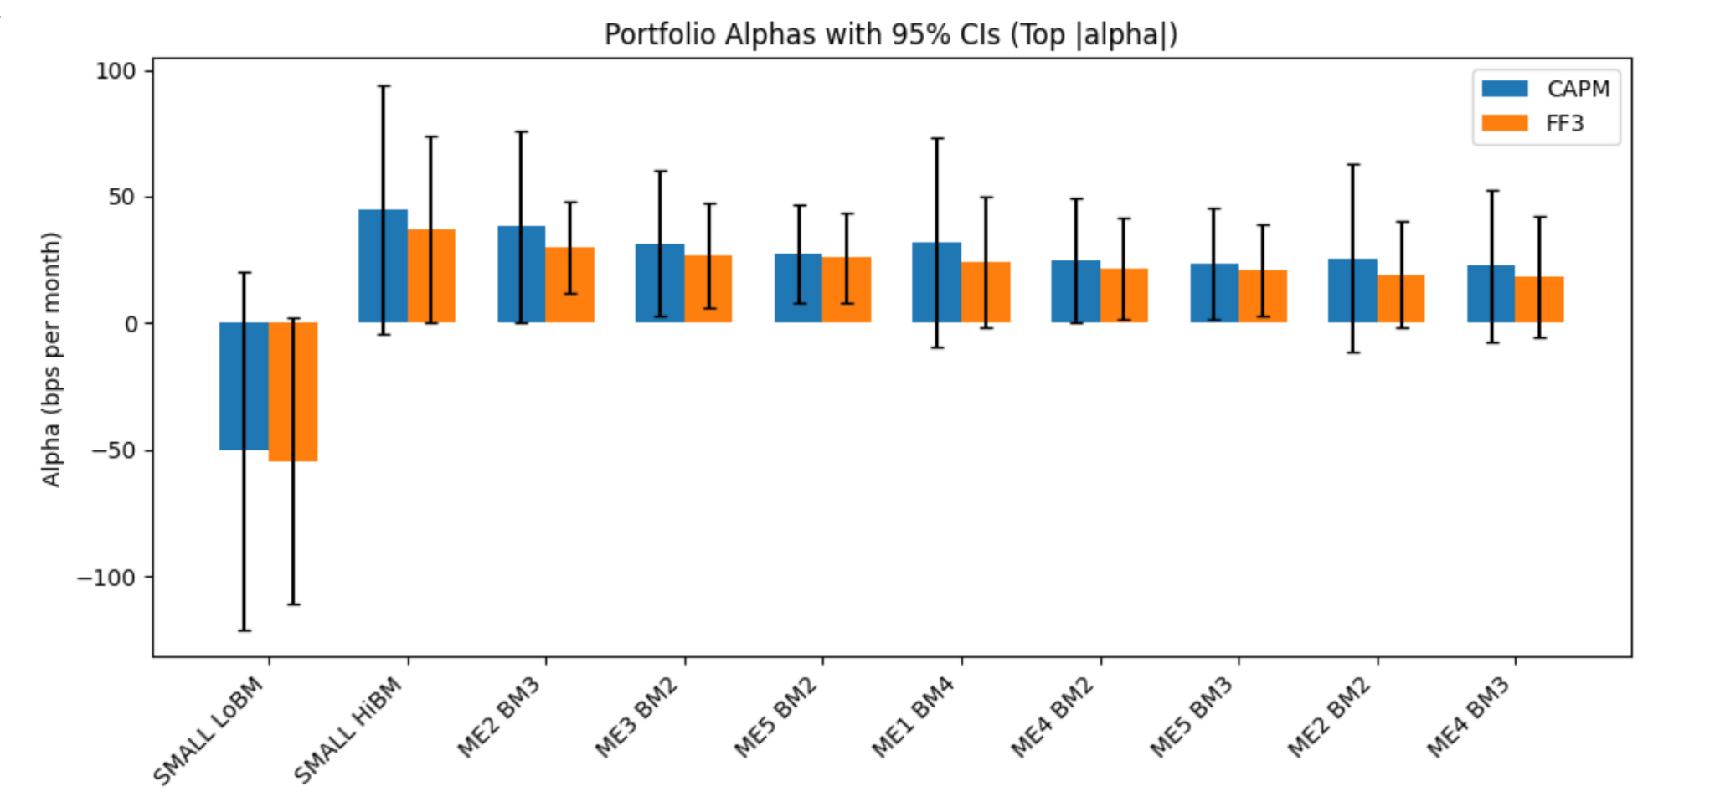
Jul-2000 to Aug-2020
Notes:
Add a quick visual of alphas or R²
Consider a bar chart of alphas for CAPM vs FF3 (first 10 portfolios is fine), or a side-by-side table of average R² and mean |alpha|.
This gives a quick visual sense of how FF3 “shrinks” alphas and improves fit, instead of just stating it.

Slide 12
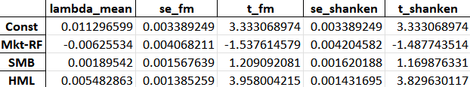
Fama–MacBeth Cross-Sectional Results
HML (p < 0.01) → strong value premium.
SMB weakly priced.
Negative λₘ implies market factor may be over-compensated.
Shanken adjustment did not alter significance materially.
After accounting for market, size, and value factors, there remains an average unexplained return (pricing bias) across portfolios.
The FF3 model still doesn’t completely explain returns (though it does better than CAPM).
Notes:
Briefly mention why Shanken correction matters
You list it but don’t explain. Add a short note:
“The Shanken correction adjusts standard errors to account for the fact that betas are estimated rather than known. This avoids understating standard errors in the second pass.”

Slide 13
Interpretation
Key Takeaways
CAPM fails jointly (large pricing errors).
Adding SMB & HML improves fit → R²↑ & α↓.
Value effect dominant driver of returns.
Partial support for multi-factor models in explaining cross-section.
Economic Implication
Markets reward exposure to systematic value risk.
Investors should account for multi-dimensional risk beyond market beta.

